Slide 1
Notes on using and customizing this presentation…
Use this presentation when speaking to groups of residents about recycling in your community.
This is designed to be a TEMPLATE PowerPoint presentation. You’ll note that there is no formatting. We encourage you to personalize this document to suit your local needs.
Please feel free to adapt this by dropping in your existing PowerPoint design template as well as any preferred fonts, colors, etc. Also, use images from your community when possible to add a personal touch.
Areas where you see red text indicate where you need to provide local and specific program information (i.e., collection days, type of container, hauler information, etc.)

Slide 2
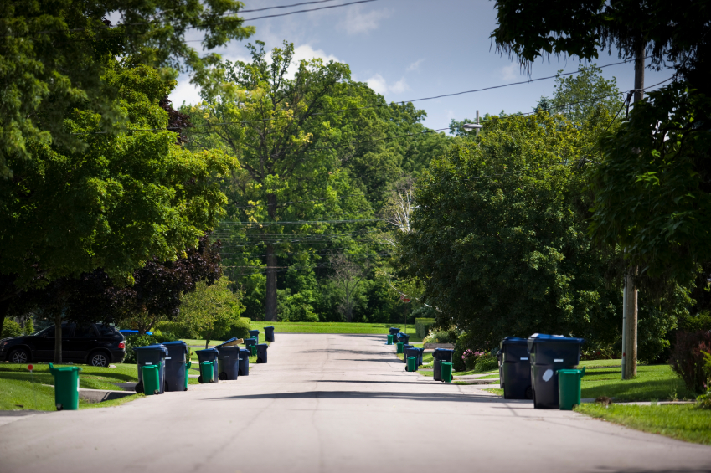
Curbside Recycling in MUNICIPALITY
Date
Meeting

Slide 3
Agenda
Curbside Recycling in MUNICIPALITY
Recycling program overview & guidelines
SWALCO
A look at the new recycling campaign …
How you can do YOUR part
Q&A

Slide 4
Curbside Recycling Program Basics
95-gallon carts available for free/$XX.
Request your cart/bin from Department, phone number.
Single-stream collection – no sorting required!
Collection occurs every Wednesday at the curb.
Visit www.yourwebsite.com to view your collection schedule online. (NOTE: If you do not have a webpage, use www.RecycleFirstTrashLast.org)

Slide 5
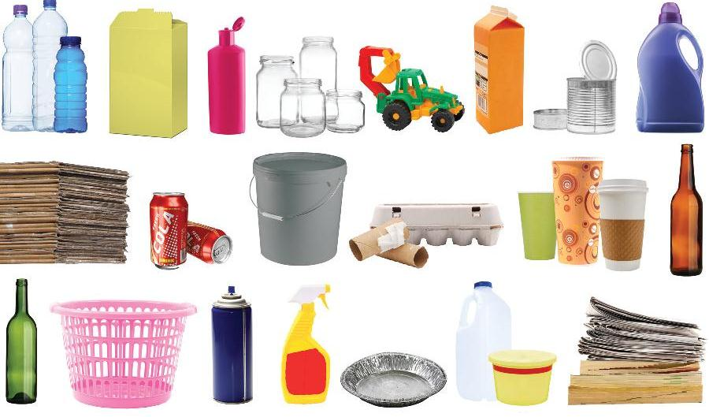
All this and more is recyclable in Lake County …

Slide 6
For full recycling guidelines, visit www.RecycleFirstTrashLast.org

Slide 7
Our community is part of a group of communities that make up the Solid Waste Agency of Lake County.
This matters to you because…
We collaborate as a County to ensure we are providing the best service and the best information about recycling.
The SWALCO Strategic Plan calls for 60% waste diversion from landfills. Currently we are at 39% diversion.
This means we need residents to recycle MORE!

Slide 8
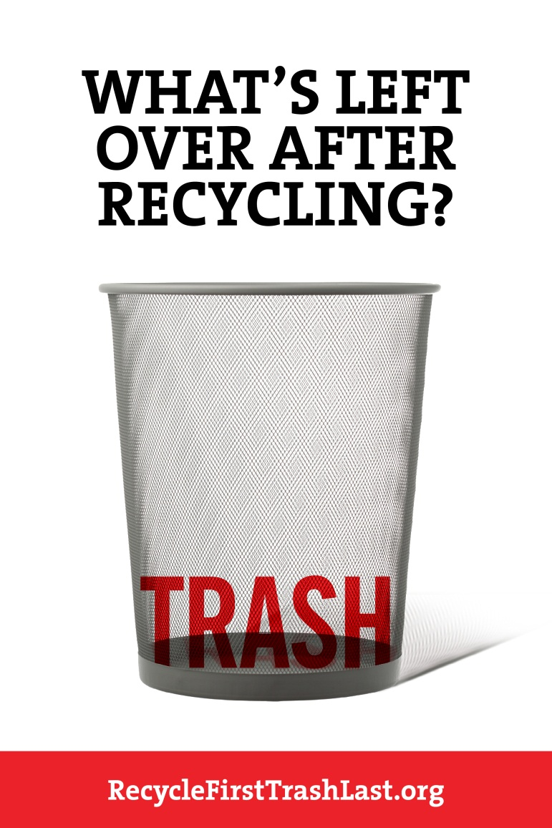
New Recycling Campaign: “Recycle First. Trash Last.”
Notes:
There's an interesting opportunity in recycling's life cycle to begin to transition the mindset from one of pulling recyclables out of the trash, to, ideally, pulling the trash out of the recycling.
This campaign puts the priority on recycling first...and defining what's left...as trash...and visualizing "trash" as nearly (ideally) non-existent. More than just something not to send to the landfill, recycling becomes a valuable resource.
Recycling first and trashing last makes the act of reclaiming these resources a proactive part of people's everyday habits.

Slide 9
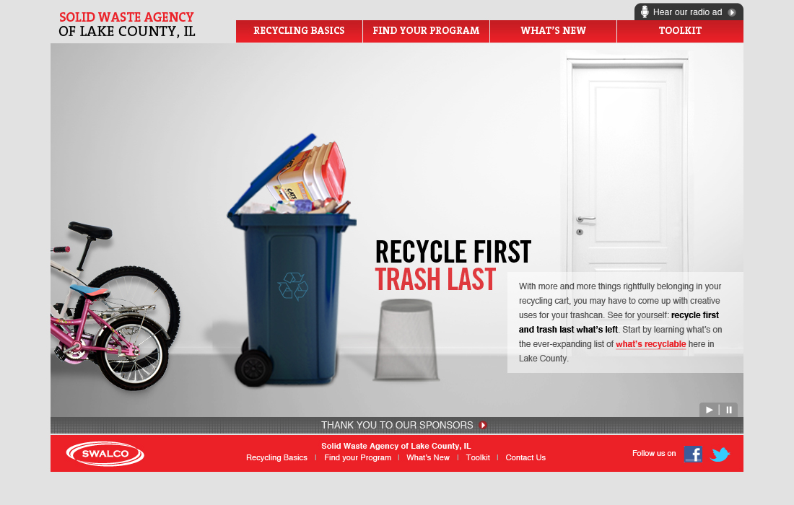
www.RecycleFirstTrashLast.org
Notes:
If connected to Internet access, click on the website link to play the video on the site.

Slide 10
We need YOUR support!
Recycle in every room of your house, not just the kitchen.
Get your kids involved in recycling!
Share information about the curbside recycling program with your family, friends and neighbors.
Visit www.RecycleFirstTrashLast.org for more information about recycling in Lake County.

Slide 11
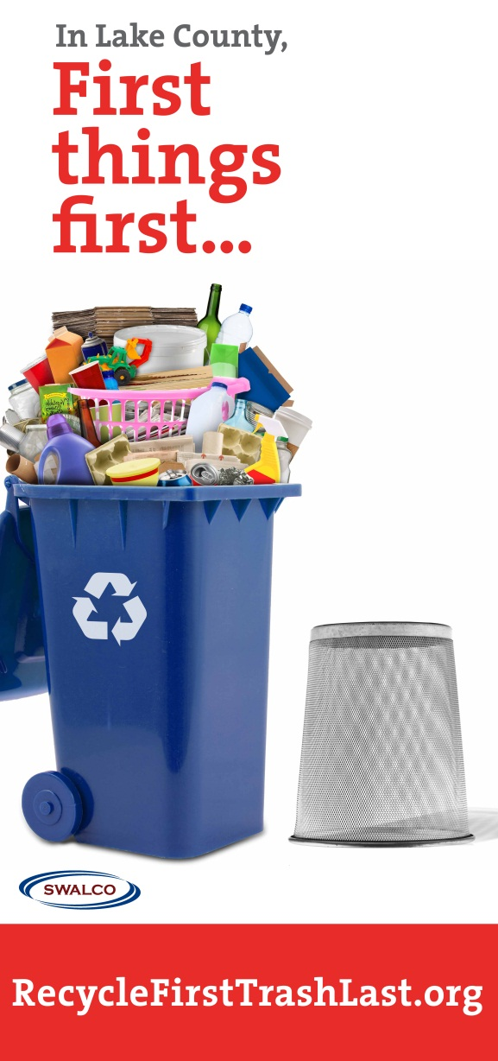
Tips for Recycling
Keep your recycling container in a kitchen pantry or by a trash can so it’s convenient to throw recyclables in it.
Keep a small grocery bag in your car to bring in recyclables such as cans and water bottles so they don’t get trashed.
Be your neighborhood’s “Recycling Champion.”

Slide 12
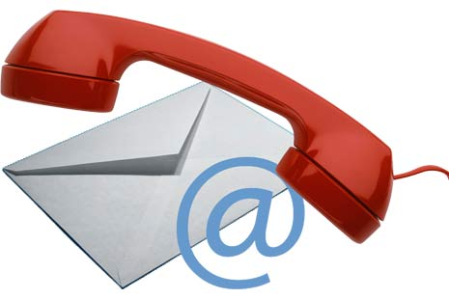
Contact Us
Name, Title, Organization
Phone number
E-mail address
Name, Title, Organization
Phone number
E-mail address

Slide 13
Questions?

